Slide 1
Analysis of Coral Reef Bleaching
Team 4: Aly, Aryavir, Brandon, Jocelyn, Linh, Maya, Phillip

Slide 2
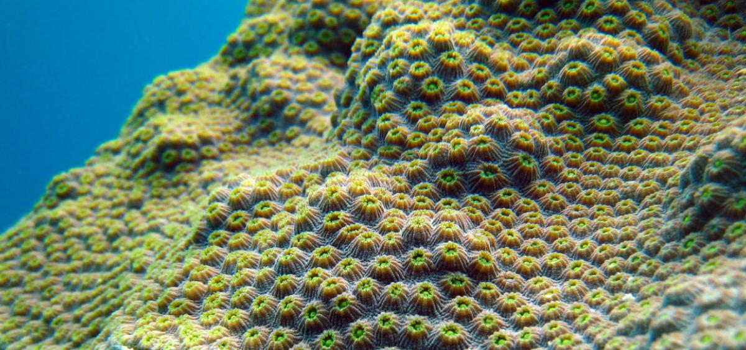
What is Coral Reef Bleaching?
Coral and algae are in a symbiotic relationship
The corals emit ammonium -> nutrient for algae
Algae undergo photosynthesis and emit nutrients back to the coral
Rise is temperature throughout the global has caused stressful conditions for the coral
In stressful conditions the coral expel the algae living on them

Slide 3
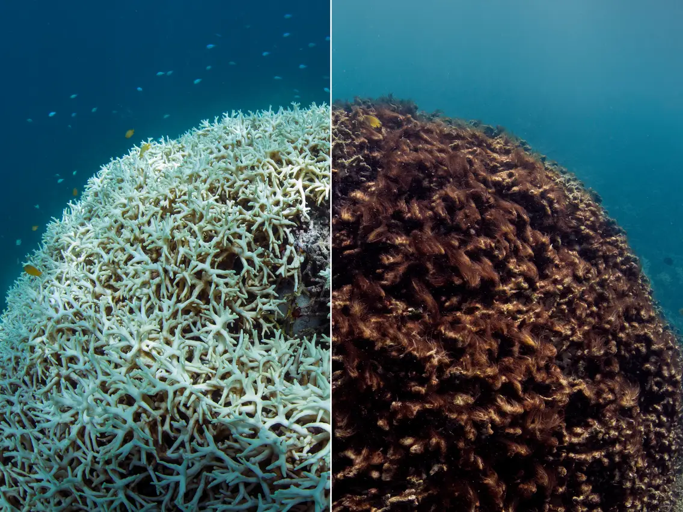
Why does Coral Reef Bleaching Matter?
Coral bleaching deteriorates the entire reef ecosystems
Thousands of marine animals depend on coral reefs for survival
Protection from predators
Food chain
Coral reefs absorb the force of waves and storm surges, keeping coastal communities safe
Notes:
Reefs rarely come back after coral bleaching => deteriorate the entire reef ecosystems
In terms of wildlife, Coral reefs provide shelter and protection from predators. They also support organisms at the base of ocean food chains.
https://www.worldwildlife.org/pages/everything-you-need-to-know-about-coral-bleaching-and-how-we-can-stop-it#:~:text=Why%20does%20coral%20bleaching%20matter,people%20and%20wildlife%20depend%2C%20deteriorate.

Slide 4
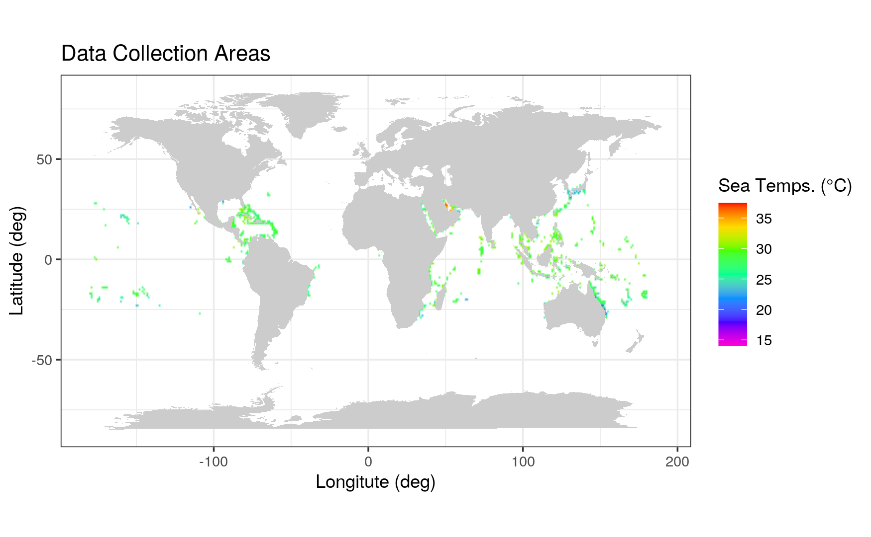
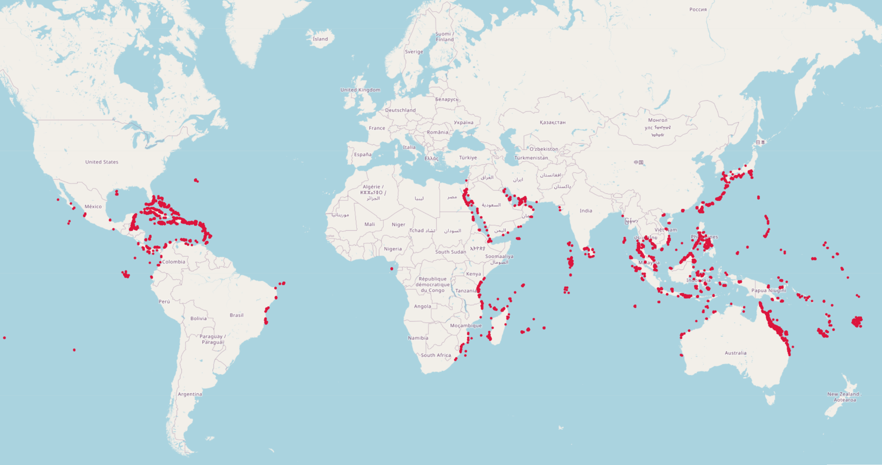
Introduction to Data
8 Ocean “Realms”
Data collected from 1980-2020
Temperature between 25-30 ℃
Near Equator
Notes:
8 Realms: from Pacific and Atlantic Oceans
Latitude: near equator
Temperature range between 25-30 deg c

Slide 5
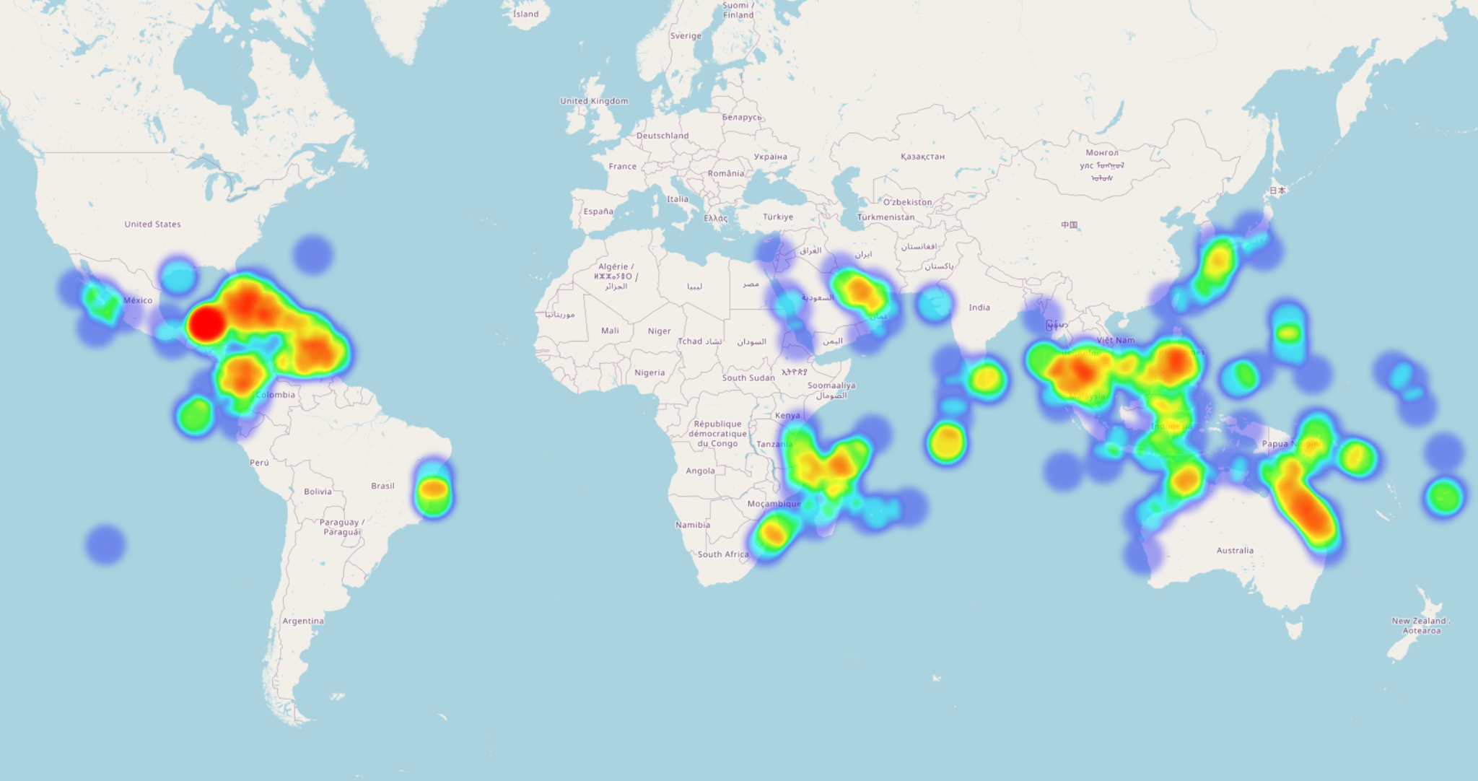
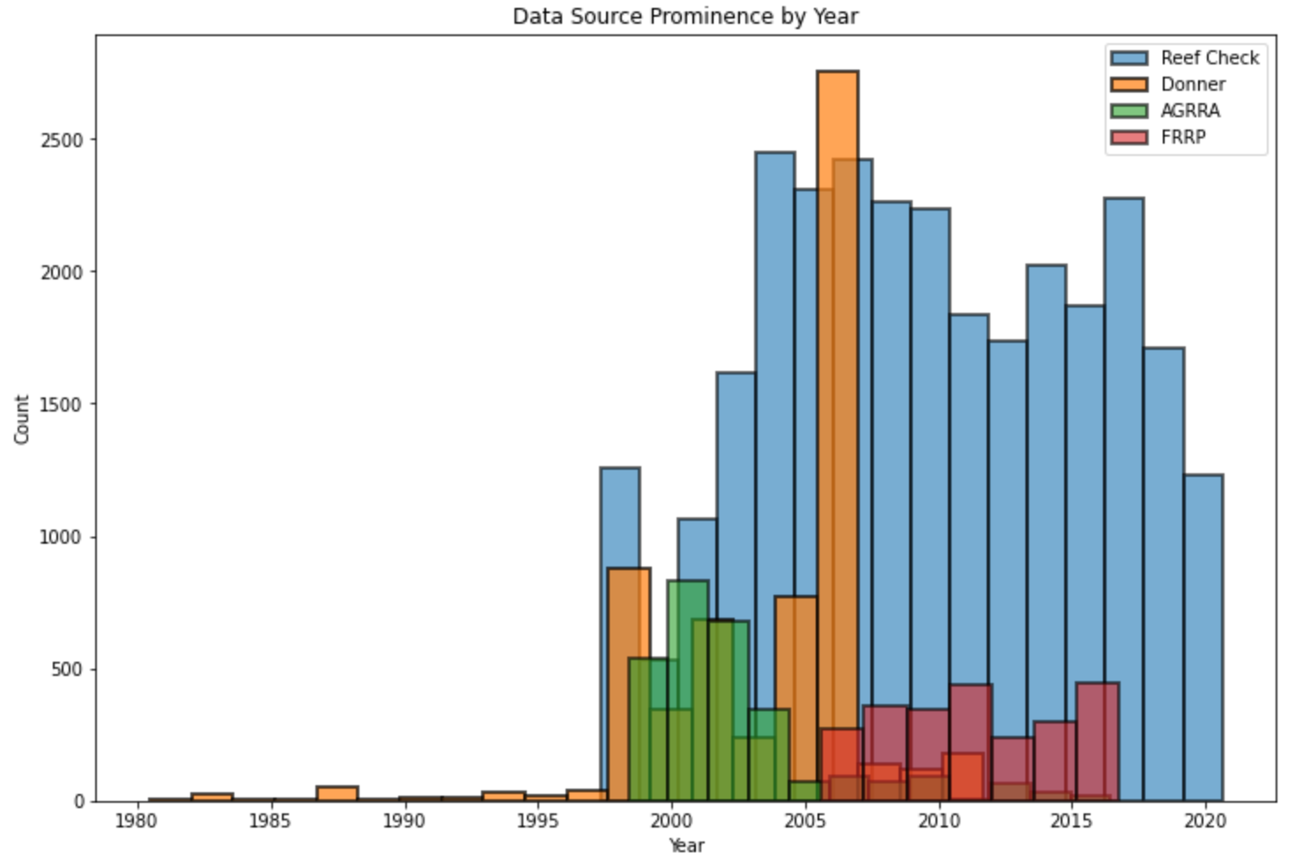
Introduction to Data Cont.
4 main data sources
Majority 1997-2020
Intense Bleaching concentrated in:
Caribbean, South China Sea, Tasmanian Sea
Notes:
Histogram of data sources
No data from before 1997
Heatmap of data weighted by bleaching %
Intense bleaching located in …

Slide 6
Hypotheses
Bleaching percent will increase as water temperature increases
Coral that is closer to the shore will experience more bleaching than coral further from the shore
Bleaching percent will decrease as turbidity increases
Bleaching percent will decrease as cyclone frequency increases

Slide 7
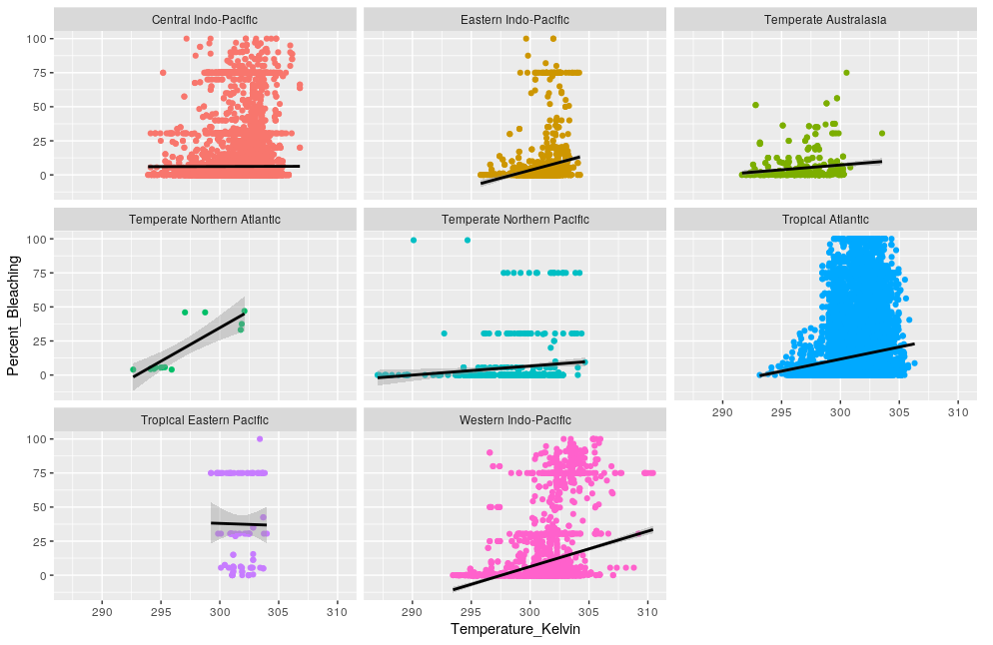
Bleaching Percent vs. Temperature
Correlation strength depends on the ocean realm
General positive trend for most ocean realm
Notes:
Correlation strength depends on the ecoregion
Correlation wasn’t as strong as we would have thought
General positive trend for most ecoregions
However, there was some regions, (Central Indo-Pacific & Tropical Eastern Pacific) that had a neutral or negative correlation:
Demonstrates that while temperature is a factor, it is not the end all be all for the graphs, and variations among the ecoregions can influence bleaching as well
Central Indo-Pacific, Eastern Indo-Pacific, Temperate Australasia, Temperate Northern Atlantic, Temperatre

Slide 8
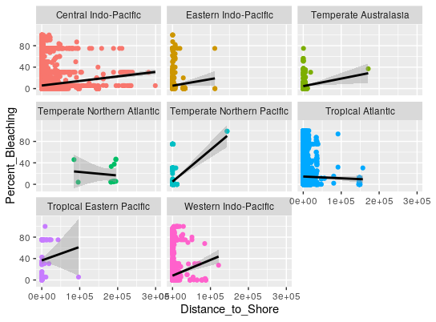
Bleaching Percent vs. Distance to Shore
Distance to shore slightly positively correlates with bleaching percent
Farther away from the shore, water tends to be warmer in the summer months
Notes:
Correlation wasn’t as strong as we would have thought

Slide 9
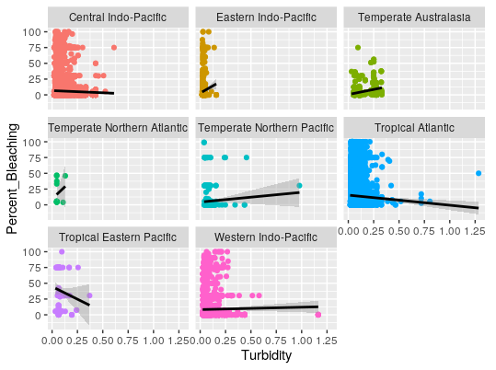
Bleaching Percent vs. Turbidity
Turbidity shows a negative correlation with the bleaching percentage.
Turbidity is the relative clarity of a liquid measured by the amount of light scattered by the water when light is passed through.
A high turbidity rating means a large number of suspended sediments in the water sample, making it more harmful for aquatic life.

Slide 10
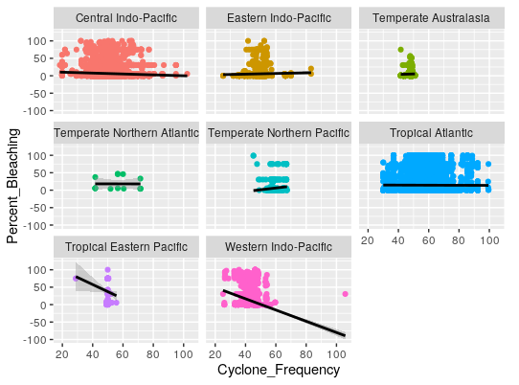
Bleaching Percent vs. Cyclone frequency
Cyclone frequency was neutrally correlated in some regions, and negatively correlated in others, such as the Western Indo-Pacific to percent bleaching
Cyclone frequency can also increase turbidity

Slide 11
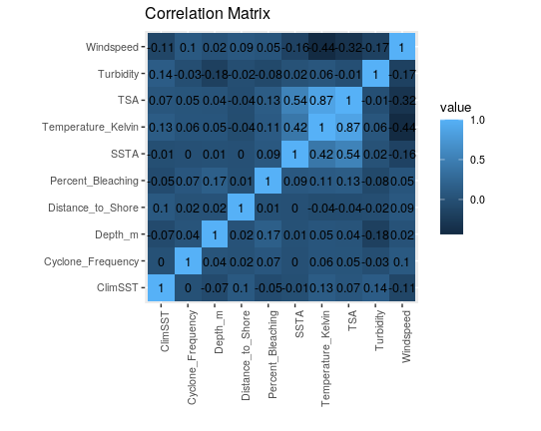
Correlation Matrix

Slide 12
Correlation Matrix
Percent bleaching is positively correlated with depth (m), total survey area (TSA), temperature (Kelvin), sea surface temperature anomaly (SSTA), Cyclone frequency, wind speed and distance to shore in this order (i.e. Depth (m) is maximum and Distance to Shore is minimum).
Percent Bleaching is negatively correlated with Turbidity and climatological Sea Surface temperature.

Slide 13
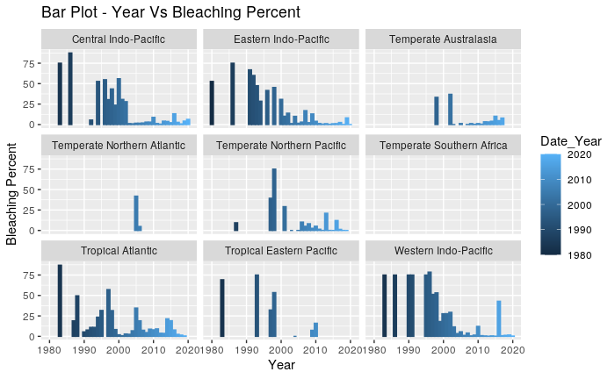
Bleaching Percent vs. Year
Looking at the correlation matrix we decided to plot the bleaching percentage vs the year
We can see that bleaching percentage over the years has gone down regardless of the location
A possible source of error is that the corals that have been analyzed have died and have been bleached to their maximum capacity

Slide 14
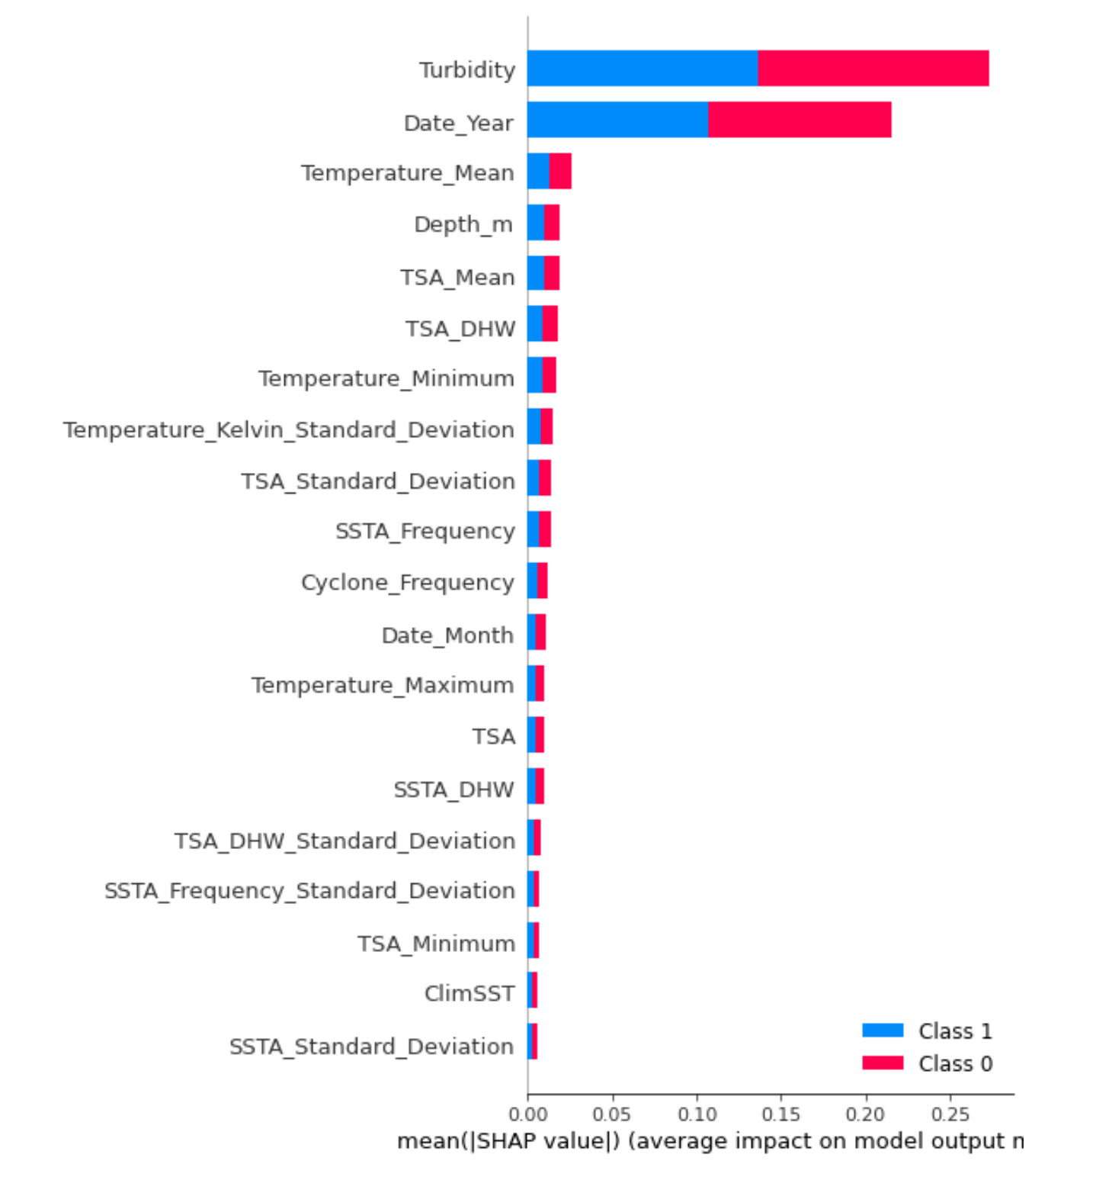
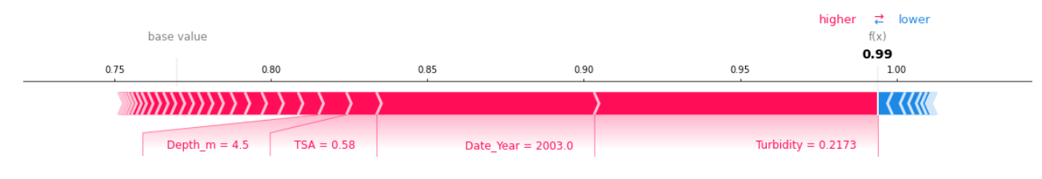
SHAP Plots for Bleaching Percent
Random Forest classifier
Turbidity and Year

Slide 15
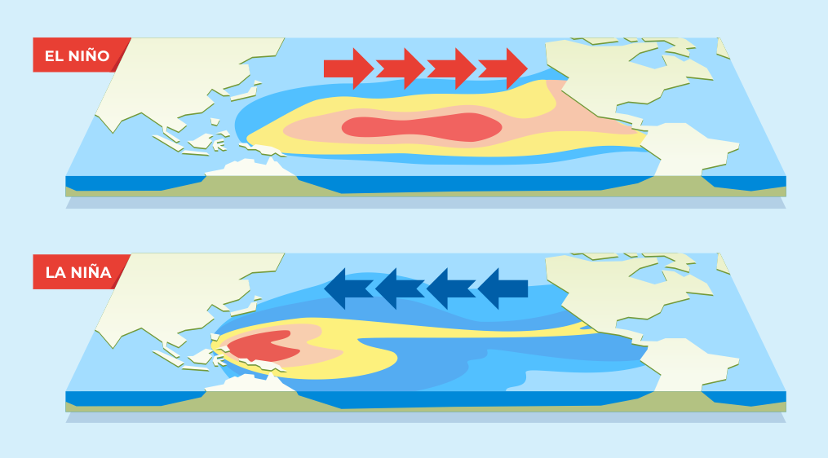
El Niño-Southern Oscillation (ENSO) cycle
Major Pacific Ocean climate pattern affecting weather worldwide
El Niño/La Niña: 2 opposing phases breaking normal conditions
El Niño: warmer ocean temps
La Niña: cooler ocean temps
https://youngzine.org/news/climate-science/la-ni%C3%B1a-back-scientists-say
Notes:
Gonna talk about esno cycle
ESNO cycle is the major pacific ocean climate pattern that can affect weather worldwide
EN/LN refers to 2 opposing climate patterns breaking normal conditions
EN characterized by warmer temps
LN characterized by cooler ocean temps

Slide 16
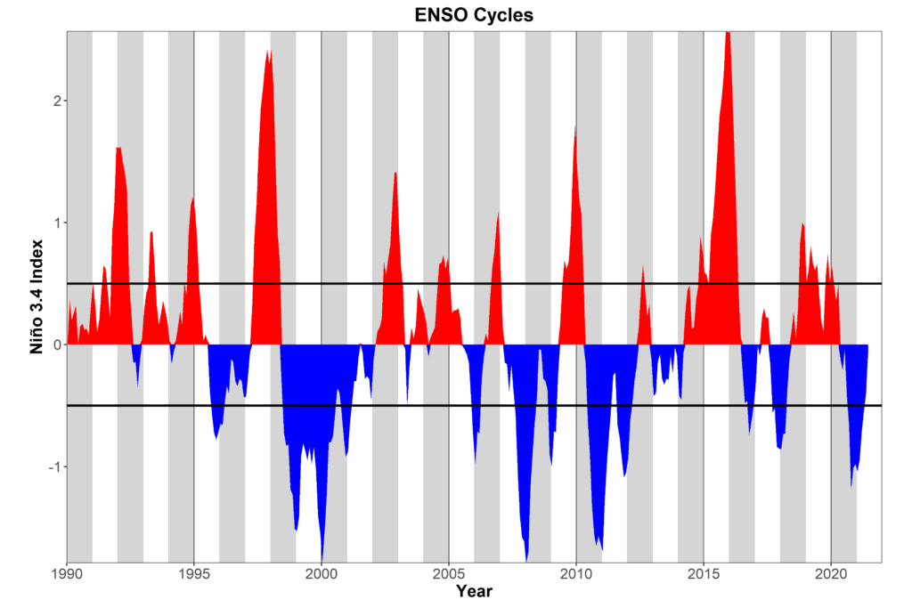
ENSO Study Method
EN/LN cycles last up to 2 years, happen every 2-7 years
Split dataset into strong EN/LN, neutral years
Past (1996-2004)
More Recent (2007-2020)
https://www.worldclimateservice.com/2021/08/25/what-is-el-nino/
Notes:
So the EN/LN cycles last up to 3months-2 years, and happen every 2-7 years
So for this study i split the dataset into years classified as strong EN/LN years and neutral years, for both a subset of past years and a set of more recent years

Slide 17
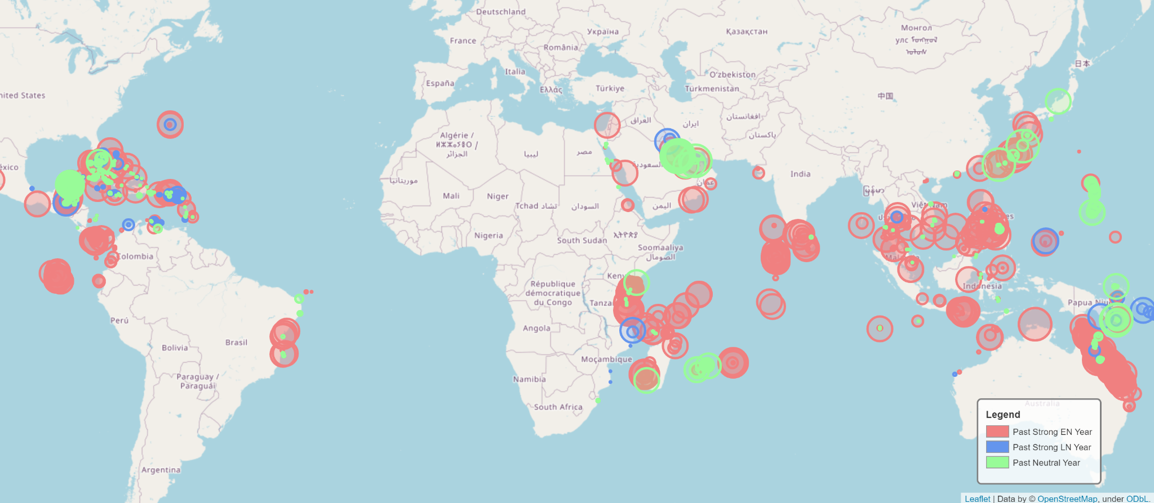
Bleaching is Historically Cyclical
Notes:
Historically in the past bleaching is very cyclical and follows ESNO patterns.
Here the light red circles are bleaching percentages in EL NINO years, so you can see that bleaching tended to happen mostly in EN years and then the corals would have time to recover in LN/off years

Slide 18
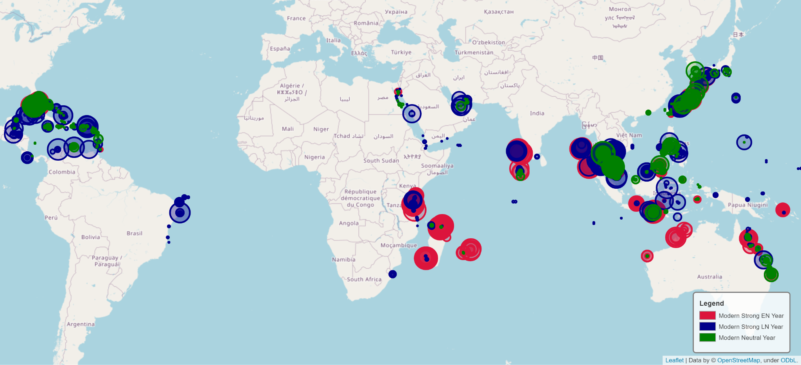
Bleaching Events are Becoming More Common
Notes:
So this is for the subset of recent years,
As you can see bleaching is becoming more common across all phases which is what makes coral bleaching so dangerous

Slide 19
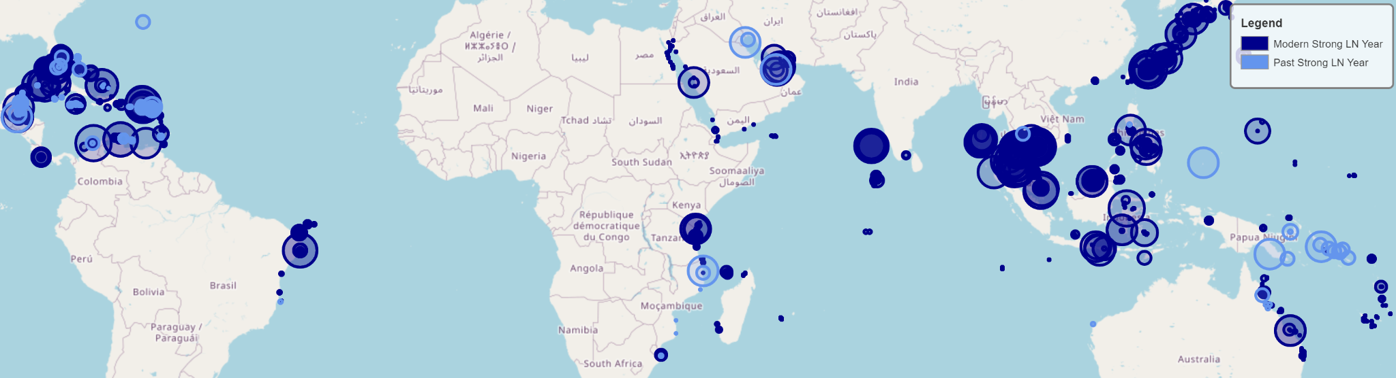
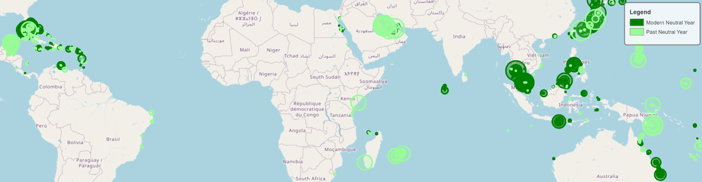
Corals Don’t Have Time to Recover
Notes:
The result is that corals dont have time to recover now
By contrast the more recent la nina and neutral years see more bleaching than in the past, which causes corals to die off faster

Slide 20
Limitations
Data was collected from coral reefs even if coral had died
- Bleaching percent decreased over the years
Very little data from 1980-1997

Slide 21
Conclusion
Temperature and distance to shoreline seem to be directly correlated to bleaching percent for most Ocean Realms
Turbidity is negatively correlated to the bleaching percentage
Bleaching follows ESNO cycles but is becoming more common across all phases

Slide 22
Questions?

Slide 23
References
Carlson RR, Li J, Crowder LB and Asner GP (2022). Large-scale effects of turbidity on coral bleaching in the Hawaiian islands. Front. Mar. Sci. 9:969472. doi: 10.3389/fmars.2022.969472.
Coral bleaching. (n.d.-a). XL Catlin Seaview Survey. Retrieved November 29, 2022, from https://www.catlinseaviewsurvey.com/coral-bleachin
Davies, R. (2022, September 30). Climate. Britannica.https://www.britannica.com/science/climate- meteorology/ Formation-of-tropical-cyclones.
Lapointe, B.E., Brewton, R.A., Herren, L.W. et al. (2019). Nitrogen enrichment, altered stoichiometry, and coral reef decline at Looe Key, Florida Keys, USA: a 3-decade study. Mar Biol 166(108) 39-46. https://doi.org/10.1007/s00227-019-3538-9.
National Oceanic and Atmospheric Administration. (2021, December 1). What is coral bleaching? National Ocean Service.
Sully, Shannon, and Robert Woesik. “Turbid Reefs Moderate Coral Bleaching under Climate‐Related Temperature Stress.” Global Change Biology, vol. 26, no. 3, 2020, pp. 1367–1373., https://doi.org/10.1111/gcb.14948.
US Department of Commerce, N. O. and A. A. (n.d.). What is coral bleaching? Retrieved November 30, 2022, from https://oceanservice.noaa.gov/facts/coral_bleach.html#:~:text=When%20water %20is%20too%20warm,and%20are%20subject%20to%20%20mortality.
US Department of Commerce, N. O. and A. A. (2002, April 16). Science education - does water temperature differ between near-shore and offshore sites? why or why not? - answer. NDBC. Retrieved November 30, 2022, from https://www.ndbc.noaa.gov/educate/seatemp_ans.shtml#:~:text=The%20waters%20just%20along%20the,surface%20temperature%20animation%20shown%20below.

